Slide 1
Introduction to Statistics for Data Analytics
© Oluwatosin Oluwadare, Ph.D. 2024
Department of Computer Science , University of Colorado, Colorado springs.
CS 2020 and dase 2020
Introduction to statistics for data analystics
Spring 2024
Lecture 13: Hypothesis Testing IV
(Chi-Square tests)

Slide 2
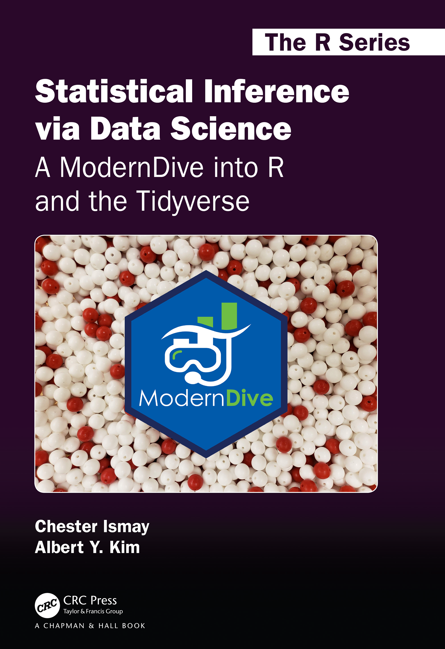
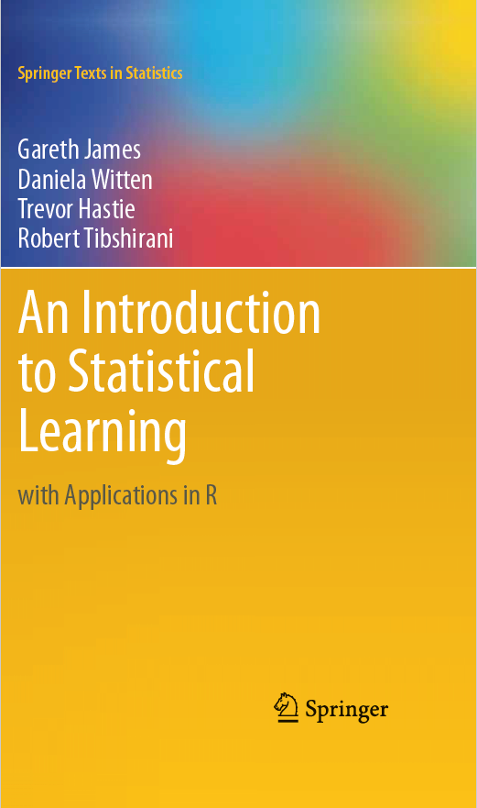
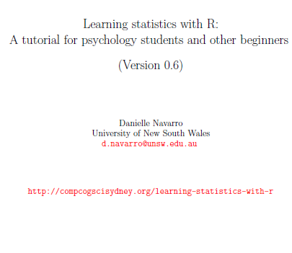

Credits
Our Main Textbook for the course:
  Ismay, Chester, and Albert Y. Kim. Statistical inference via data science: A ModernDive into R and the tidyverse. Chapman and Hall/CRC, 2019. Get an electronic copy from the UCCS Library. Or
  See open source copy of the textbook here: https://moderndive.com/ .
CS 2020 shared Resource from Dr. Atyabi
Jiawei Han et al., Data Mining Text- book
Some referenced online resources in the slide deck

Slide 3
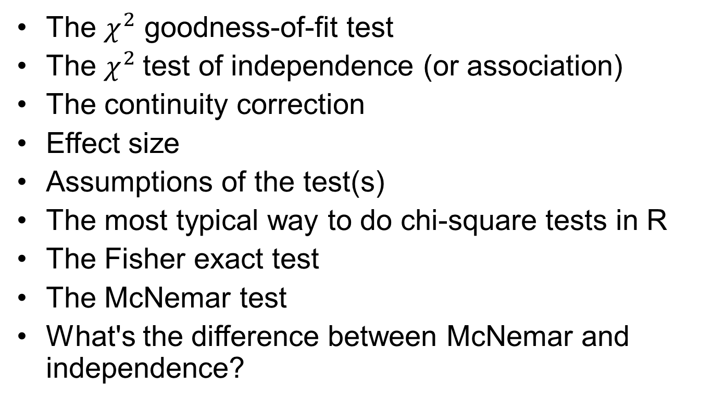
Outline
The $χ^{2}$ goodness-of-fit test
The $χ^{2}$test of independence (or association)
The continuity correction
Effect size
Assumptions of the test(s)
The most typical way to do chi-square tests in R
The Fisher exact test
The McNemar test
What's the difference between McNemar and independence?

Slide 4
Chi-Square Statistic
A chi-square statistic is one way to show a relationship between two categorical variables.
It is among the most common nonparametric tests.
Nonparametric tests are used for data that don't follow the assumptions of parametric tests, especially the assumption of a normal distribution.
It shows the relationship between qualitative variables
The chi square hypothesis test is appropriate if you have:
  Discrete outcomes (categorical) — No Order
  Dichotomous variables: are categorical variables with two categories or levels — different groups within the same independent variable. Heads or Tails, Rich or Poor, Democrat or Republican, Pass or Fail.
  Ordinal variables— With a Clear Ordering
Notes:
https://www.statisticshowto.com/dichotomous-variable/
Bruin, J. 2006. newtest: command to compute new test. UCLA: Statistical Consulting Group. https://stats.oarc.ucla.edu/stata/ado/analysis/.

Slide 5
Chi-Square Statistic
There are two types of chi-square tests. Both use the chi-square statistic and distribution for different purposes:
  A chi-square goodness of fit test determines if sample data matches a population. It is to fit one categorical variable to a distribution.
  A chi-square test for independence compares two variables in a contingency table to see if they are related. In a more general sense, it tests to see whether distributions of categorical variables differ from each another.

Slide 6
Chi-Square Statistic
The formula for the chi-square statistic used in the chi square test is:

Slide 7
Correlation Analysis (Nominal Data)
Χ² (chi-square) test
The larger the Χ² value, the more likely the variables are related
The cells that contribute the most to the Χ² value are those whose actual count is very different from the expected count
Correlation does not imply causality
  # of hospitals and # of car-theft in a city are correlated
  Both are causally linked to the third variable: population
  Remember Spurious correlation: https://www.tylervigen.com/spurious-correlations

Slide 8
Goodness of fit test
The goodness of fit test is it tells you if your sample data represents the data you would expect to find in the actual population.
More specifically, it is used to test if sample data fits a distribution from a certain population (i.e. a population with a normal distribution or one with a Weibull distribution).
Goodness of fit tests commonly used in statistics are:
  Chi-square.
  Kolmogorov-Smirnov.
  Anderson-Darling.
  Shapiro-Wilk.
Notes:
https://www.statisticshowto.com/goodness-of-fit-test/

Slide 9
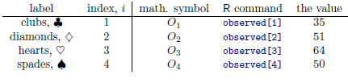

The $χ^{2}$ goodness-of-fit test
> library( lsr )
> load( "randomness.Rdata" )
> who( TRUE )
-- Name -- -- Class -- -- Size --
cards data.frame 200 x 3
$id factor 200
$choice_1 factor 200
$choice_2 factor 200
> head( cards )
id choice_1 choice_2
1 subj1 spades clubs
2 subj2 diamonds clubs
3 subj3 hearts clubs
4 subj4 spades clubs
5 subj5 hearts spades
6 subj6 clubs hearts
> observed <- table( cards$choice_1 )
> observed
clubs diamonds hearts spades
35 51 64 50
O = (O1,O2,O3,O4)
O = (35, 51, 64, 50)

Slide 10
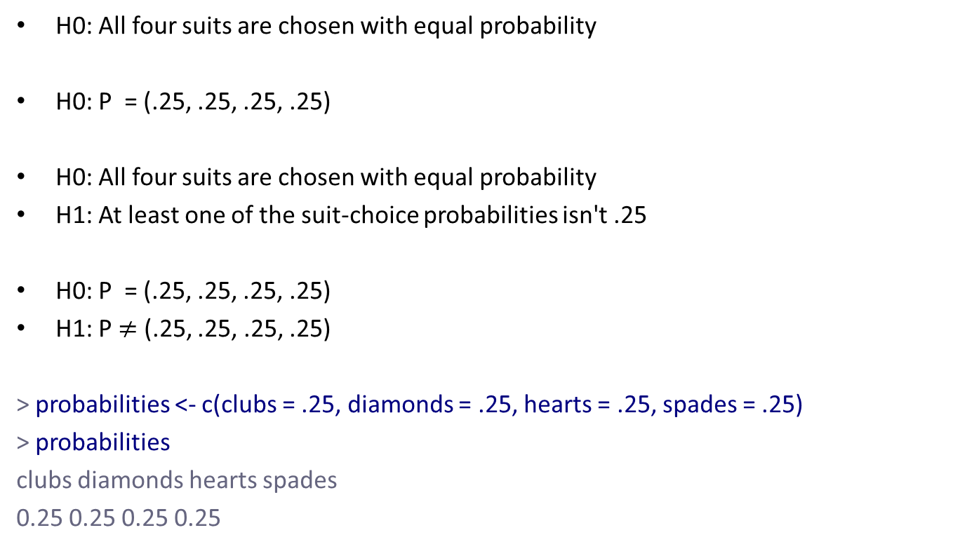
The null hypothesis and the alternative hypothesis
H0: All four suits are chosen with equal probability
H0: P = (.25, .25, .25, .25)
H0: All four suits are chosen with equal probability
H1: At least one of the suit-choice probabilities isn't .25
H0: P = (.25, .25, .25, .25)
H1: P $≠$ (.25, .25, .25, .25)
> probabilities <- c(clubs = .25, diamonds = .25, hearts = .25, spades = .25)
> probabilities
clubs diamonds hearts spades
0.25 0.25 0.25 0.25

Slide 11
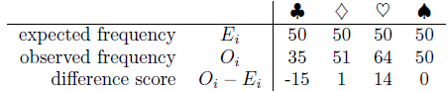
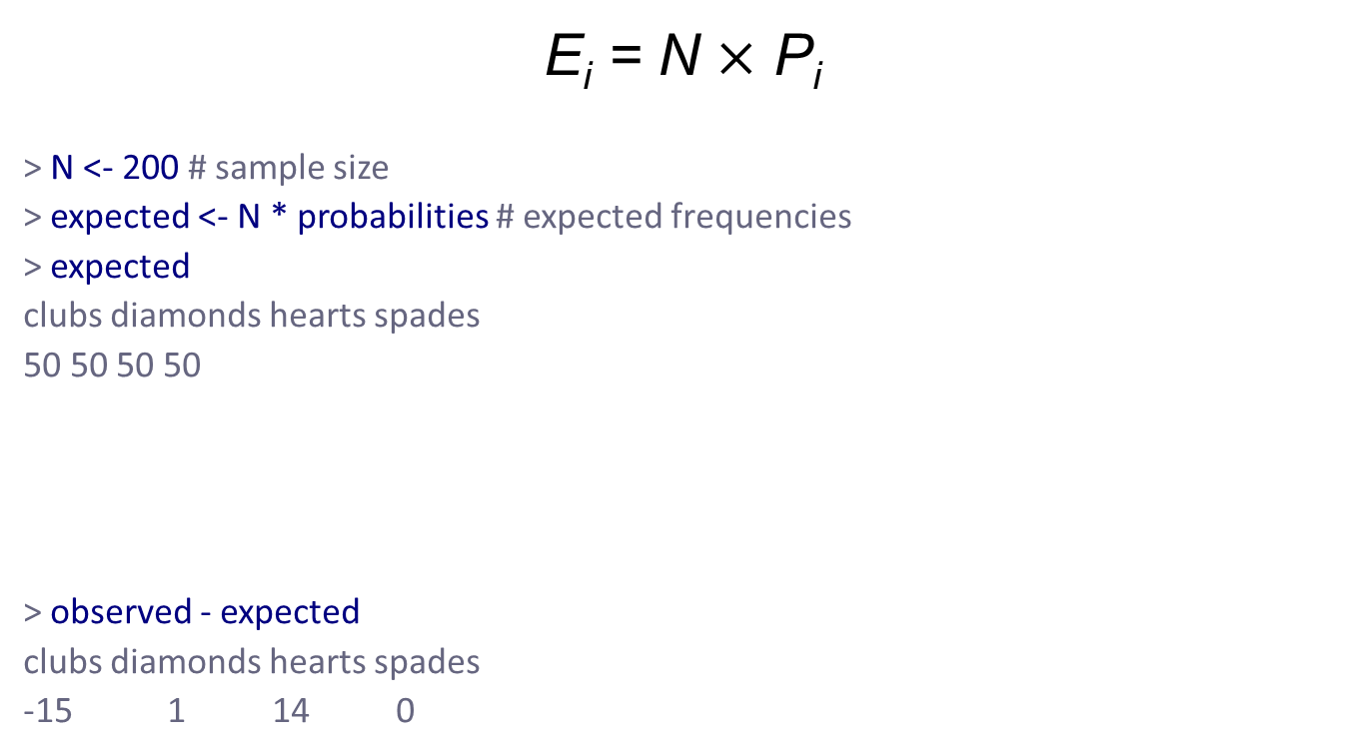
The “goodness of fit” test statistic
E_{i} = N $×$ P_{i}
> N <- 200 # sample size
> expected <- N * probabilities # expected frequencies
> expected
clubs diamonds hearts spades
50 50 50 50
> observed - expected
clubs diamonds hearts spades
-15 1 14 0

Slide 12
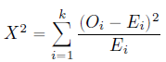
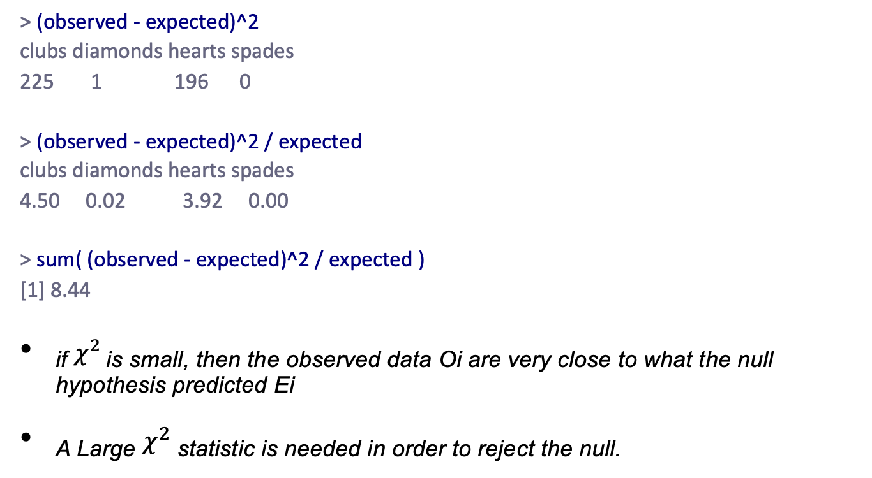
The “goodness of fit" test statistic
> (observed - expected)^2
clubs diamonds hearts spades
225 1 196 0
> (observed - expected)^2 / expected
clubs diamonds hearts spades
4.50 0.02 3.92 0.00
> sum( (observed - expected)^2 / expected )
[1] 8.44
_{if} $χ^{2}$ is small, then the observed data Oi are very close to what the null hypothesis predicted Ei
_{A Large} $χ^{2}$ statistic is needed in order to reject the null.

Slide 13
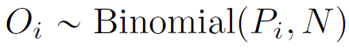
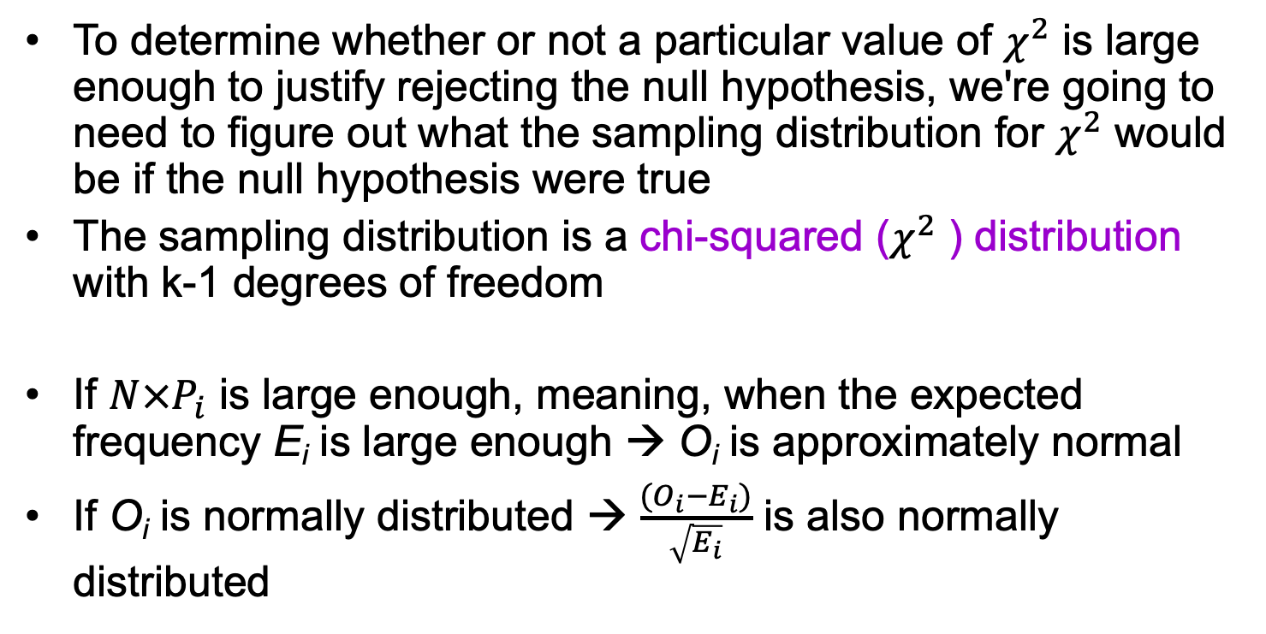
The sampling distribution of the GOF statistic
To determine whether or not a particular value of $χ^{2}$ is large enough to justify rejecting the null hypothesis, we're going to need to figure out what the sampling distribution for $χ^{2}$ would be if the null hypothesis were true
The sampling distribution is a chi-squared ($χ^{2}$ ) distribution with k-1 degrees of freedom
If $N×P_{i}$ is large enough, meaning, when the expected frequency E_{i} is large enough → O_{i} is approximately normal
If O_{i} is normally distributed → $\frac{(O_{i}−E_{i})}{\sqrt{E_{i}}}$ is also normally distributed

Slide 14

Degrees of freedom
Chi-square distributions with different values for the “degrees of freedom".

Slide 15
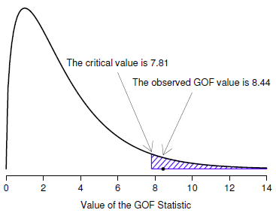
Testing the null hypothesis
> qchisq( p = .95, df = 3 )
[1] 7.814728
> pchisq( q = 8.44, df = 3, lower.tail = FALSE )
[1] 0.03774185
> 1-pchisq( q = 8.44, df = 3 )
[1] 0.03774185

Slide 16
Doing the test in R
> goodnessOfFitTest( cards$choice_1 )
Chi-square test against specified probabilities
Data variable: cards$choice_1
Hypotheses:
null: true probabilities are as specified
alternative: true probabilities differ from those specified
Descriptives:
observed freq. expected freq. specified prob.
clubs 35 50 0.25
diamonds 51 50 0.25
hearts 64 50 0.25
spades 50 50 0.25
Test results:
X-squared statistic: 8.44
degrees of freedom: 3
p-value: 0.038

Slide 17
Specifying a different null hypothesis
> nullProbs <- c(clubs = .2, diamonds = .3, hearts = .3, spades = .2)
> nullProbs
clubs diamonds hearts spades
0.2 0.3 0.3 0.2
> goodnessOfFitTest( x = cards$choice_1, p = nullProbs )
Chi-square test against specified probabilities
Data variable: cards$choice_1
Hypotheses:
null: true probabilities are as specified
alternative: true probabilities differ from those specified
Descriptives:
observed freq. expected freq. specified prob.
clubs 35 40 0.2
diamonds 51 60 0.3
hearts 64 60 0.3
spades 50 40 0.2
Test results:
X-squared statistic: 4.742
degrees of freedom: 3
p-value: 0.192

Slide 18
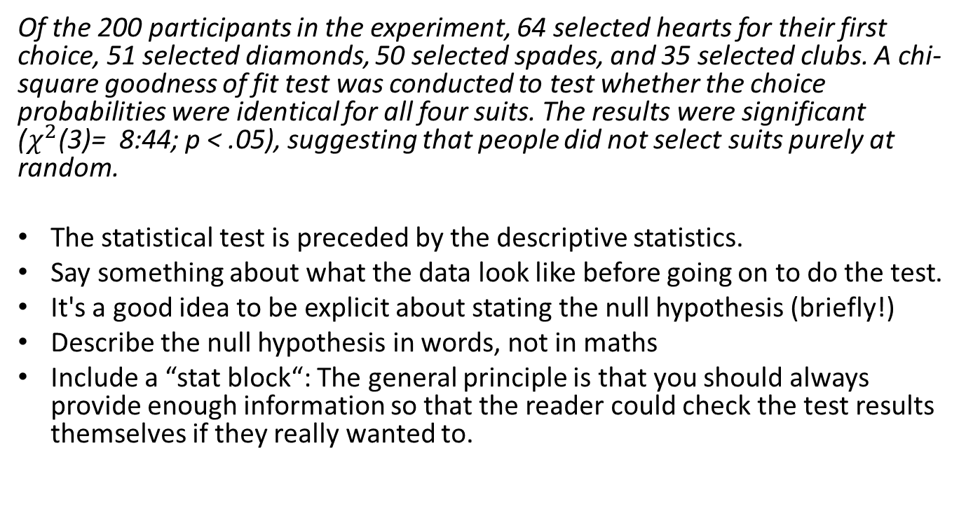
How to report the results of the test
Of the 200 participants in the experiment, 64 selected hearts for their first choice, 51 selected diamonds, 50 selected spades, and 35 selected clubs. A chi-square goodness of fit test was conducted to test whether the choice probabilities were identical for all four suits. The results were significant ($χ^{2}$(3)= 8:44; p < .05), suggesting that people did not select suits purely at random.
The statistical test is preceded by the descriptive statistics.
Say something about what the data look like before going on to do the test.
It's a good idea to be explicit about stating the null hypothesis (briefly!)
Describe the null hypothesis in words, not in maths
Include a “stat block“: The general principle is that you should always provide enough information so that the reader could check the test results themselves if they really wanted to.

Slide 19
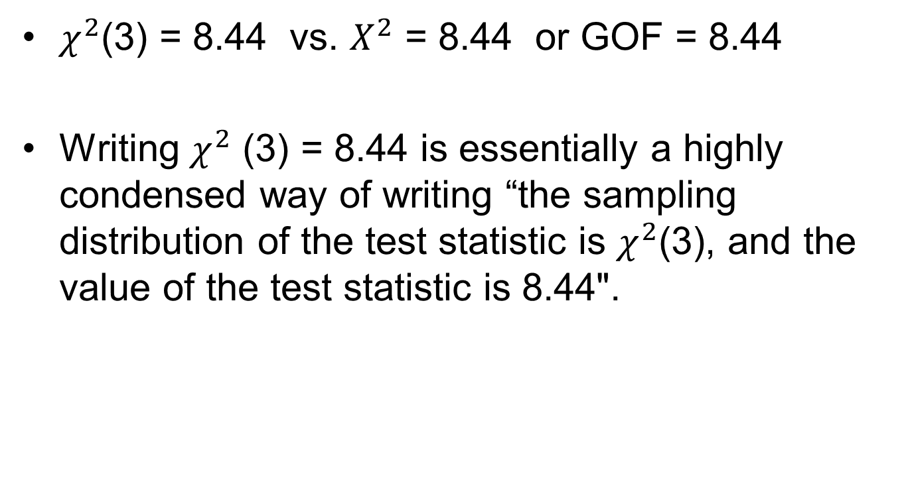
A comment on statistical notation
$χ^{2}$(3) = 8.44 vs. $X^{2}$ = 8.44 or GOF = 8.44
Writing $χ^{2}$ (3) = 8.44 is essentially a highly condensed way of writing “the sampling distribution of the test statistic is $χ^{2}$(3), and the value of the test statistic is 8.44".

Slide 20
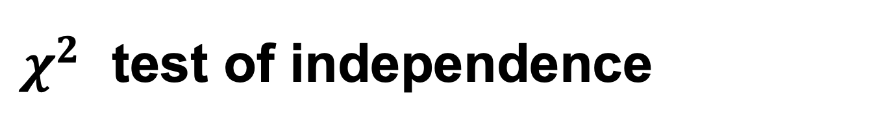
$χ^{2}$ test of independence
A chi-square test for independence compares two variables in a contingency table to see if they are related.
In a more general sense, it tests to see whether distributions of categorical variables differ from each another.

Slide 21
Chi-Square Calculation: An Example
 | Play chess | Not play chess | Sum (row)
Like science fiction | 250 | 200 | 450
Not like science fiction | 50 | 1000 | 1050
Sum(col.) | 300 | 1200 | 1500

Slide 22
Chi-Square Calculation: An Example
Steps to follow
  State the hypothesis
  Establish the significance level you need (p = 0.001, 99.9% confidence level) and the number of degrees of freedom
  Calculate the expected values
  Use the observed and expected values to calculate the chi-square test statistic
  Compare the chi-square statistic with the critical value from the table
  Make a decision about your hypothesis

Slide 23
Hypothesis
 | Play chess | Not play chess | Sum (row)
Like science fiction | 250 | 200 | 450
Not like science fiction | 50 | 1000 | 1050
Sum(col.) | 300 | 1200 | 1500
H₀ : Chess Playing or not and preferred reading are independent(no association).
H₁ : Chess Playing or not and preferred reading are not independent(association).

Slide 24
Degrees of freedom
Significance level, p = 0.001
Number of degrees of freedom is calculated by multiplying the number of rows minus 1 by the number of columns minus 1
  Degree of freedom = (r -1) x (c-1)
  For a 2 x 2 contingency table:
    (2-1) x (2-1) = 1

Slide 25
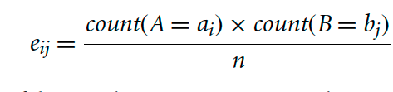
Expected Values
Observed Values
 | Play chess | Not play chess | Sum (row)
Like science fiction | 250 | 200 | 450
Not like science fiction | 50 | 1000 | 1050
Sum(col.) | 300 | 1200 | 1500
Expected Values
 | Play chess | Not play chess | Sum (row)
Like science fiction | 90 | 360 | 450
Not like science fiction | 210 | 840 | 1050
Sum(col.) | 300 | 1200 | 1500

Slide 26
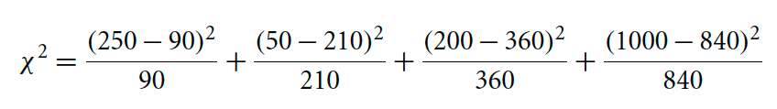
Calculation
= 284.44 + 121.90 + 71.11+ 30.48
= 507.93

Slide 27
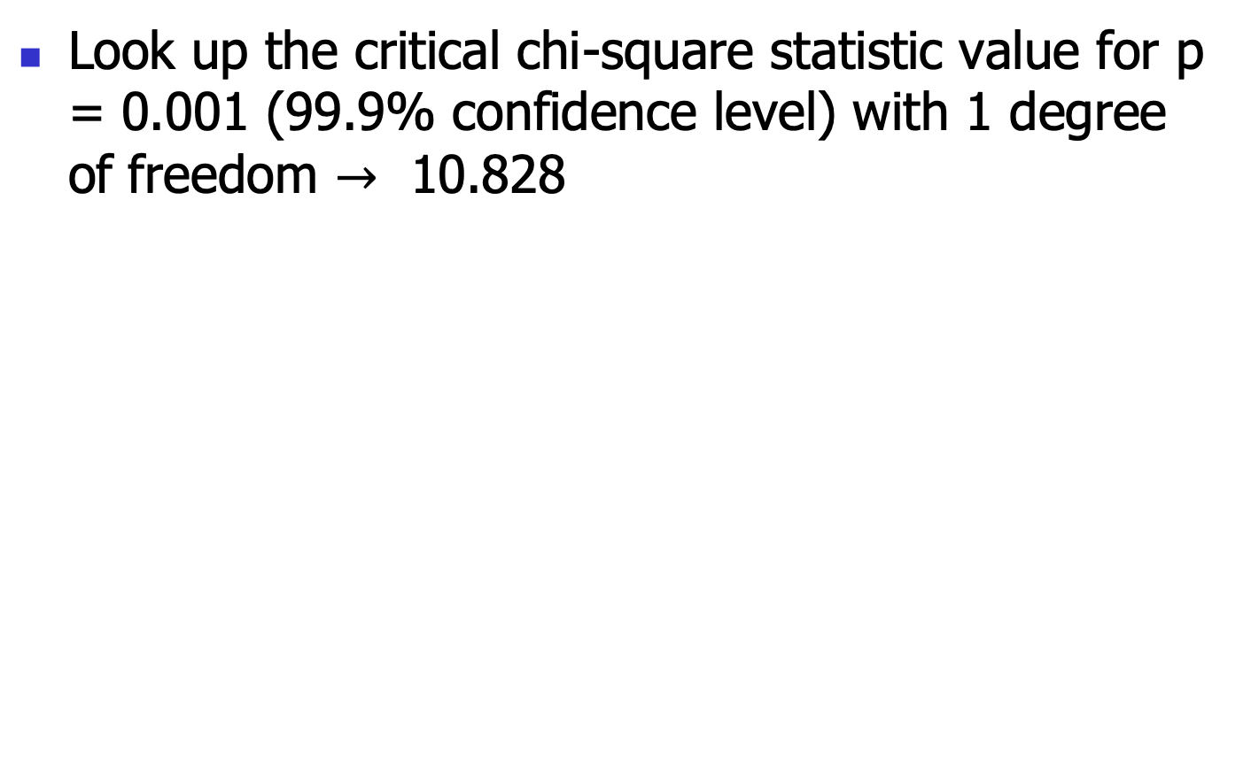
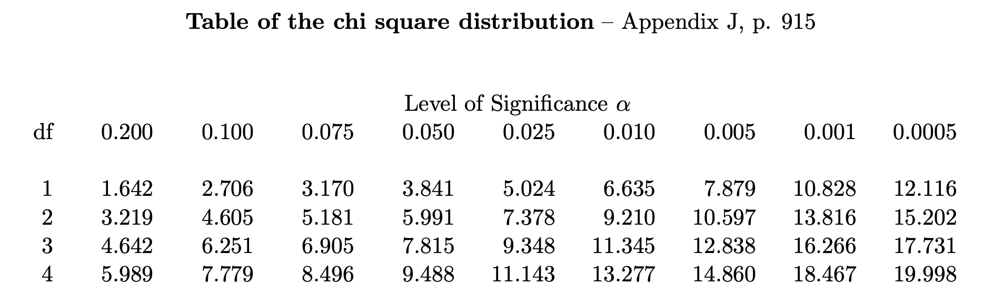
Table of Critical values
?

Slide 28
Make a Decision: Is it Significant?
Chi square Test value > table value then REJECT H₀
507.93 > 10.828
We reject H₀ ’ Chess Playing or not and preferred reading are independent’
Instead, we conclude that the two attributes are (strongly) correlated for the given group of people.

Slide 29
Chi-Square Calculation: An Example
Χ² (chi-square) calculation (numbers in parenthesis are expected counts calculated based on the data distribution in the two categories)
It shows that like_science_fiction and play_chess are correlated in the group
 | Play chess | Not play chess | Sum (row)
Like science fiction | 250(90) | 200(360) | 450
Not like science fiction | 50(210) | 1000(840) | 1050
Sum(col.) | 300 | 1200 | 1500

Slide 30
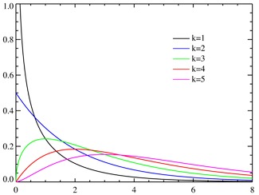
Chi Square Distribution
Degree of freedom = 1 (e.g., (r − 1)(c − 1))
For 0.001 significance, threshold = 10.828
http://en.wikipedia.org/wiki/Pearson's_chi-squared_test

Slide 31
Chi-Square Statistic
The chi-square goodness of fit test is used when you have a table of observed frequencies of different categories; and the null hypothesis gives you a set of “known" probabilities to compare them to. You can either use the goodnessOfFitTest() function in the lsr package to run this test, or the chisq.test() function.
The chi-square test of independence is used when you have a contingency table (cross-tabulation) of two categorical variables. The null hypothesis is that there is no relationship/ association between the variables. You can either use the associationTest() function in the lsr package, or you can use chisq.test().

Slide 32

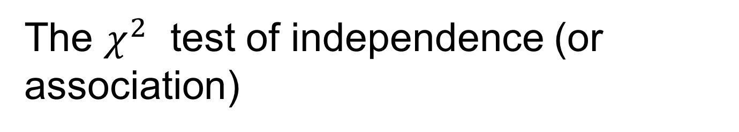
The $χ^{2}$ test of independence (or association)
> load( "chapek9.Rdata" )
> who(TRUE)
-- Name -- -- Class -- -- Size --
chapek9 data.frame 180 x 2
$species factor 180
$choice factor 180
> head(chapek9)
species choice
1 robot flower
2 human data
3 human data
4 human data
5 robot data
6 human flower
> summary(chapek9)
species choice
robot:87 puppy : 28
human:93 flower: 43
data :109
> chapekFrequencies <- xtabs( ~ choice + species, data = chapek9)
> chapekFrequencies
species
choice robot human
Puppy 13 15
flower 30 13
data 44 65

Slide 33
A little Background on the chpek9.data
– Futurama, “Fear of a Bot Planet
The other day I was watching an animated documentary examining the quaint customs of the natives of the planet Chapek 9. Apparently, in order to gain access to their capital city, a visitor must prove that they’re a robot, not a human. In order to determine whether or not visitor is human, they ask whether the visitor prefers puppies, flowers or large, properly formatted data files. “Pretty clever,” I thought to myself “but what if humans and robots have the same preferences? That probably wouldn’t be a very good test then, would it?” As it happens, I got my hands on the testing data that the civil authorities of Chapek 9 used to check this. It turns out that what they did was very simple… they found a bunch of robots and a bunch of humans and asked them what they preferred.
Notes:
SOURCE:
https://stats.libretexts.org/Bookshelves/Applied_Statistics/Book%3A_Learning_Statistics_with_R_-_A_tutorial_for_Psychology_Students_and_other_Beginners_(Navarro)/12%3A_Categorical_Data_Analysis/12.02%3A_The_2_test_of_independence_(or_association)

Slide 34


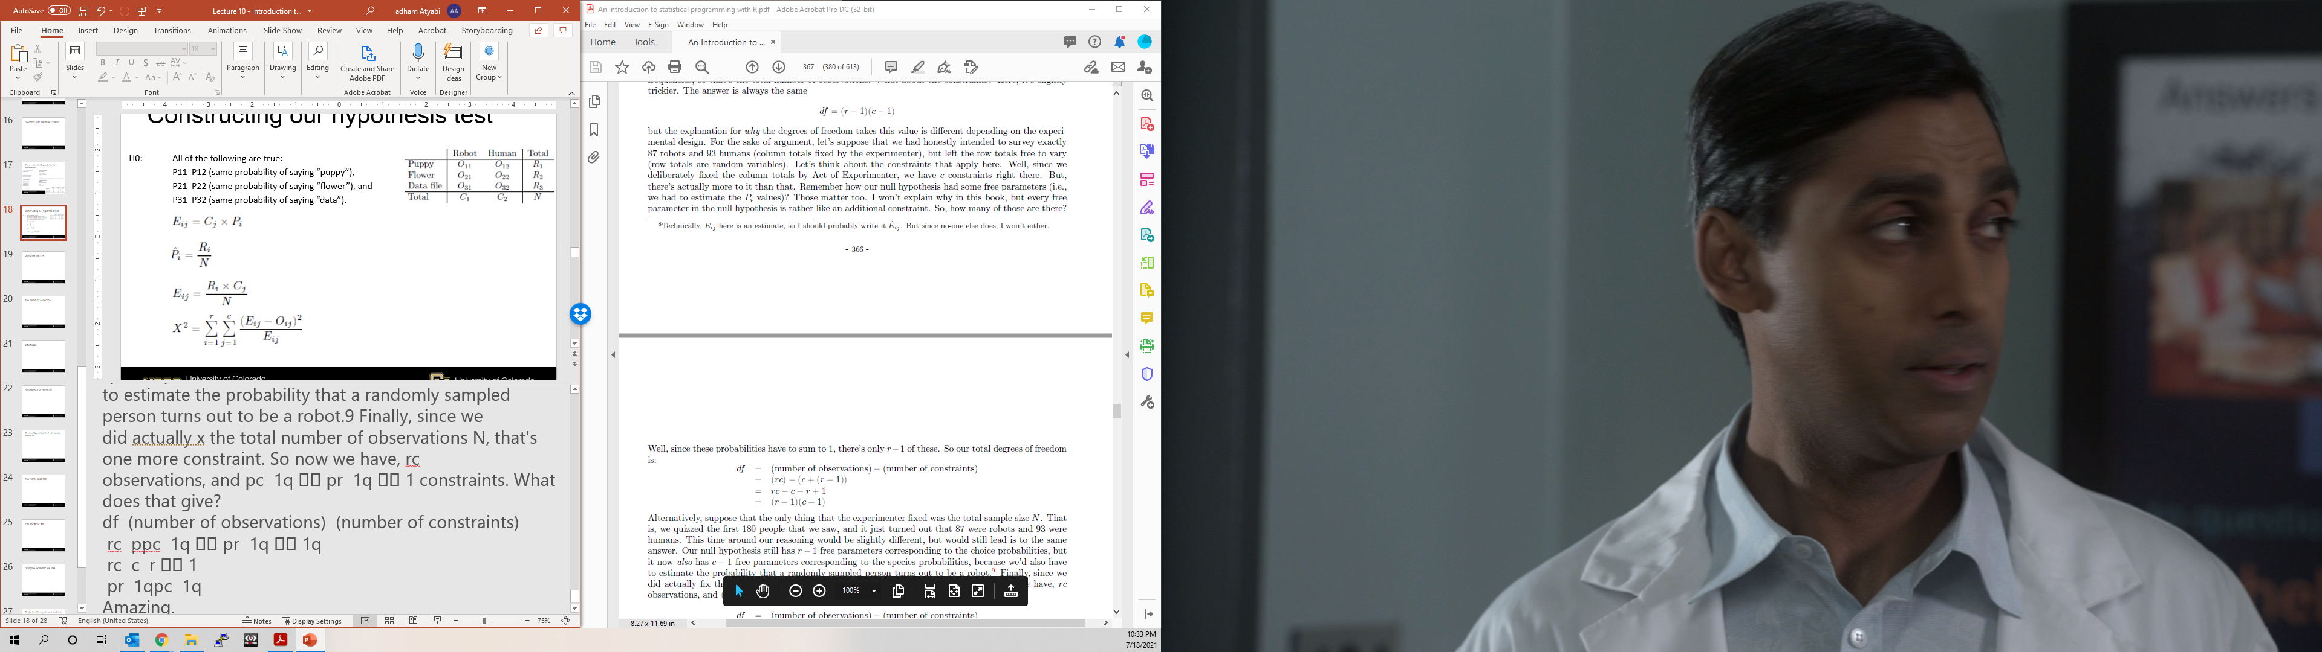

Constructing our hypothesis test
H0: All of the following are true:
P11 = P12 (same probability of saying “puppy”),
P21 = P22 (same probability of saying “flower”), and
P31 = P32 (same probability of saying “data”).

Slide 35
Doing the test in R
> xtabs( formula = ~choice+species, data = chapek9 )
species
choice robot human
puppy 13 15
flower 30 13
data 44 65
> associationTest( formula = ~choice+species, data = chapek9 )
Chi-square test of categorical association
Variables: choice, species
Hypotheses:
null: variables are independent of one another
alternative: some contingency exists between variables

Slide 36

Doing the test in R
Pearson's $χ^{2}$ revealed a significant association between species and choice ($χ^{2}$(2)= 10.7, p <.01): robots appeared to be more likely to say that they prefer flowers, but the humans were more likely to say they prefer data.
The fact that humans appeared to have a stronger preference for raw data less than robots is somewhat counterintuitive. However, in context it makes some sense: the civil authority on Chapek9 has an unfortunate tendency to kill and dissect humans when they are identified. As such it seems most likely that the human participants did not respond honestly to the question, so as to avoid potentially undesirable consequences. This should be considered to be a substantial methodological weakness.
Observed contingency table:
species
choice robot human
puppy 13 15
flower 30 13
data 44 65
Expected contingency table under the null hypothesis:
species
choice robot human
puppy 13.5 14.5
flower 20.8 22.2
data 52.7 56.3
Test results:
X-squared statistic: 10.722
degrees of freedom: 2
p-value: 0.005
Other information:
estimated effect size (Cramer's v): 0.244

Slide 37
Assumptions of the test(s)
Expected frequencies are sufficiently large. The default assumption seems to be that you generally would like to see all your expected frequencies larger than about 5, though for larger tables you would probably be okay if at least 80% of the expected frequencies are above 5 and none of them are below 1.
Data are independent of one another.

Slide 38
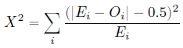
Yate’s Continuity Correction: Definition & Example
The chi-square test assumes that the discrete probabilities of the frequencies in a contingency table can be approximated by the Chi-Square distribution, which is a continuous distribution.
To correct for this bias we can apply Yate’s continuity correction

Slide 39
Yate’s Continuity Correction: Definition & Example
We typically only use this correction when at least one cell in the contingency table has an expected frequency less than 5.
Notes:
https://www.statology.org/yates-continuity-correction/

Slide 40
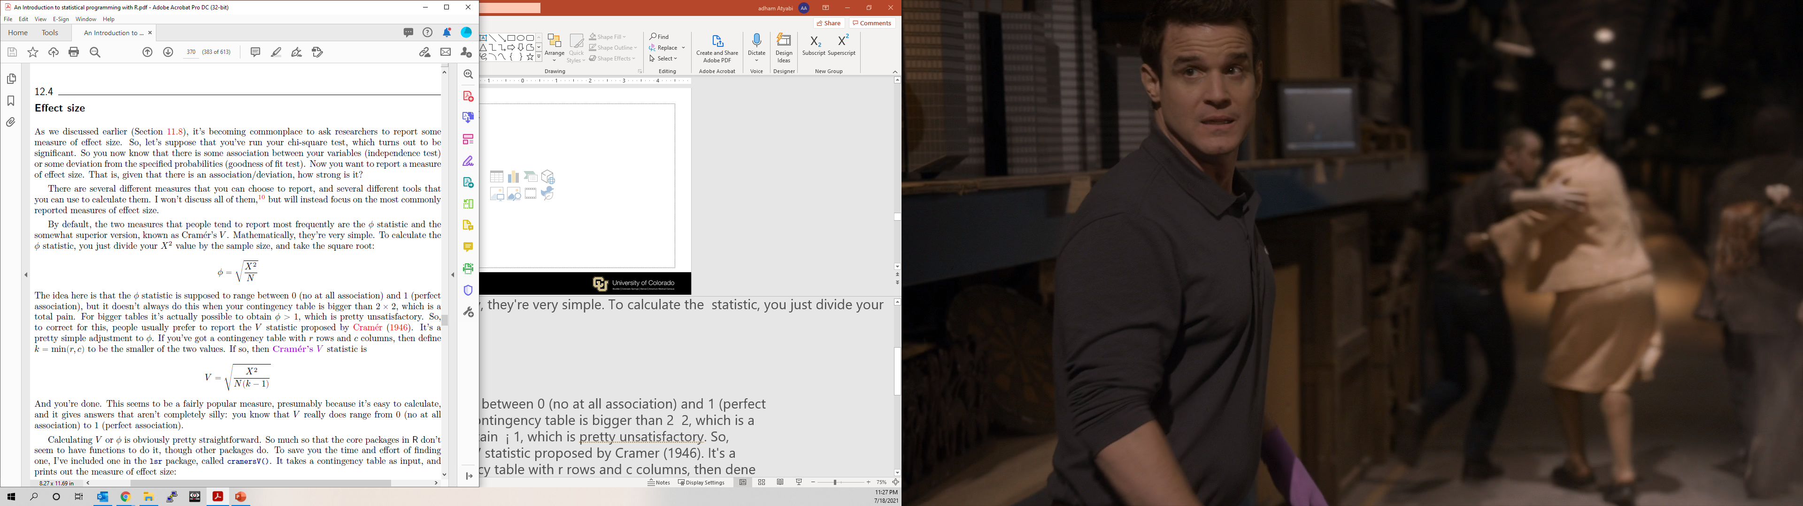
Effect size measurement for the chi-square test of independence
Measuring the of the strength of association between two nominal variables.
ϕ statistic and Cramer’s V are the two most famous approaches to measure effect size
where k=min(r,c)
> cramersV( chapekFrequencies )
[1] 0.244058

Slide 41
Effect Size
Phi (ϕ):
  A value of .1 is considered a small effect, .3 a medium effect, and .5 a large effect.
Cramer’s V ranges from 0 to 1 where:
  0 indicates no association between the two variables.
  1 indicates a perfect association between the two variables.

Slide 42
The most typical way to do chi-square tests in R
> observed
clubs diamonds hearts spades
35 51 64 50
> chisq.test( x = observed )
Chi-squared test for given probabilities
data: observed
X-squared = 8.44, df = 3, p-value = 0.03774
> chisq.test( x = observed, p = c(.2, .3, .3, .2) )
Chi-squared test for given probabilities
data: observed
X-squared = 4.7417, df = 3, p-value = 0.1917
> chapekFrequencies
species
choice robot human
puppy 13 15
flower 30 13
data 44 65
> chisq.test( chapekFrequencies )
Pearson's Chi-squared test
data: chapekFrequencies
X-squared = 10.7216, df = 2, p-value = 0.004697

Slide 43
Fisher Exact Test
This is a Fisher exact test calculator for a 2 x 2 contingency table. The Fisher exact test tends to be employed instead of Pearson's chi-square test when sample sizes are small.
Like the chi-square test is used for test of independence is among the Nonparametric tests
This test can be done online at https://www.langsrud.com/fisher.htm , https://www.socscistatistics.com/tests/fisher/default2.aspx

Slide 44
Fisher Exact Test
The Fisher Exact test uses the following formula:
P = ( ( a + b ) ! ( c + d ) ! ( a + c ) ! ( b + d ) ! ) / a ! b ! c ! d ! N !
In this formula, the ‘a,’ ‘b,’ ‘c’ and ‘d’ are the individual frequencies of the 2X2 contingency table, and ‘N’ is the total frequency.
The Fisher Exact test uses this formula to obtain the probability of the combination of the frequencies that are actually obtained.
It also involves the finding of the probability of every possible combination which indicates more evidence of association.
Notes:
https://www.statisticssolutions.com/fisher-exact-test/#:~:text=The%20Fisher%20Exact%20test%20uses,(%20a%20%2B%20c%20)%20!

Slide 45
Fisher Exact Test
See Publications that have used Fisher’s exact Test here: https://www.sciencedirect.com/topics/medicine-and-dentistry/fisher-exact-test

Slide 46

The Fisher exact test
> load("salem.Rdata")
> who(TRUE)
-- Name -- -- Class -- -- Size --
trial data.frame 16 x 2
$happy logical 16
$on.fire logical 16
> salem.tabs <- table( trial )
> print( salem.tabs )
on.fire
happy FALSE TRUE
FALSE 3 3
TRUE 10 0
> chisq.test( salem.tabs )
Pearson's Chi-squared test with Yates' continuity correction
data: salem.tabs
X-squared = 3.3094, df = 1, p-value = 0.06888
Warning message:
In chisq.test(salem.tabs) : Chi-squared approximation may be incorrect
> fisher.test( salem.tabs )
Fisher's Exact Test for Count Data
data: salem.tabs
p-value = 0.03571
alternative hypothesis: true odds ratio is not equal to 1
95 percent confidence interval:
0.000000 1.202913
sample estimates:
odds ratio
0

Slide 47
McNemar test
The McNemar test is used to determine if there are differences on a dichotomous dependent variable between two related groups.
The McNemar test is a non-parametric test used to analyze paired nominal data. It is a test on a 2 x 2 contingency table and checks the marginal homogeneity of two dichotomous variables.
The test requires one nominal variable with two categories (dichotomous) and one independent variable with two dependent groups (norminal).
It can be considered to be similar to the paired-samples t-test, but for a dichotomous rather than a continuous dependent variable.
However, unlike the paired-samples t-test, it can be conceptualized to be testing two different properties of a repeated measure dichotomous variable, as is explained below.
Notes:
https://www.ncbi.nlm.nih.gov/books/NBK560699/
https://statistics.laerd.com/spss-tutorials/mcnemars-test-using-spss-statistics.php

Slide 48
McNemar test Example
You could use the McNemar's test to determine whether the proportion of participants who felt safe (yes or no) differed when wearing a cycling helmet as opposed to wearing no cycling helmet (i.e., the dependent variable would be "sense of safety", which has two categories: "safe" and "not safe").
  Sense of safety: one nominal (dichotomous dependent—yes or no) variable
  Helmet: one categorical independent variable with two related groups. Wearing or Not Wearing
The McNemar's test has three assumptions that must be met. If these assumptions are not met, you cannot use a McNemar's test, but may be able to use another statistical test instead.
Notes:
https://www.ncbi.nlm.nih.gov/books/NBK560699/
https://statistics.laerd.com/spss-tutorials/mcnemars-test-using-spss-statistics.php

Slide 49
Assumptions
Assumption #1: You have one categorical dependent variable with two categories (i.e.,a dichotomous variable) and one categorical independent variable with two related groups.
Examples of dichotomous variables include perceived safety (two groups: "safe" and "unsafe"), exam performance (two groups: "pass" and "fail"), preferred choice of cereal brand (two groups: "brand A" and "brand B"), feeling of seasickness (two groups: "yes" and "no").
Notes:
https://www.ncbi.nlm.nih.gov/books/NBK560699/
https://statistics.laerd.com/spss-tutorials/mcnemars-test-using-spss-statistics.php

Slide 50
Assumptions
Assumption #2: The two groups of your dependent variable must be mutually exclusive. This means that no groups can overlap. In other words, a participant can only be in one of the two groups; they cannot be in both groups at the same time.
For example, imagine you were using a McNemar's test to determine whether the proportion of participants who passed an exam (as opposed to failing the exam) before a two week revision period (i.e., an intervention) increased after the intervention (i.e., your dependent variable would be "exam performance", which has two categories: "pass" and "fail").
When a participant took the exam before the two week revision period, they could have only "passed" it or "failed" it. They could not pass and fail at the same time
Notes:
https://www.ncbi.nlm.nih.gov/books/NBK560699/
https://statistics.laerd.com/spss-tutorials/mcnemars-test-using-spss-statistics.php

Slide 51
Assumptions
Assumption #3: The cases (e.g., participants) are a random sample from the population of interest. However, in practice, this is not always how sampling took place.

Slide 52
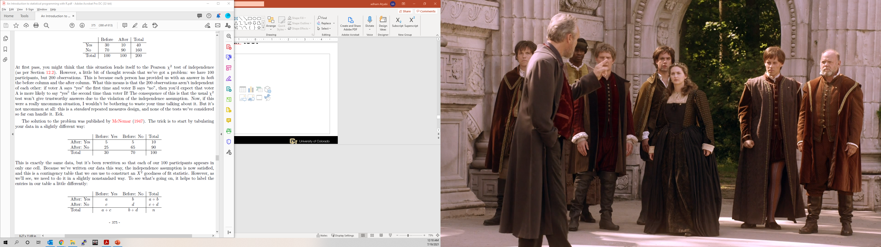
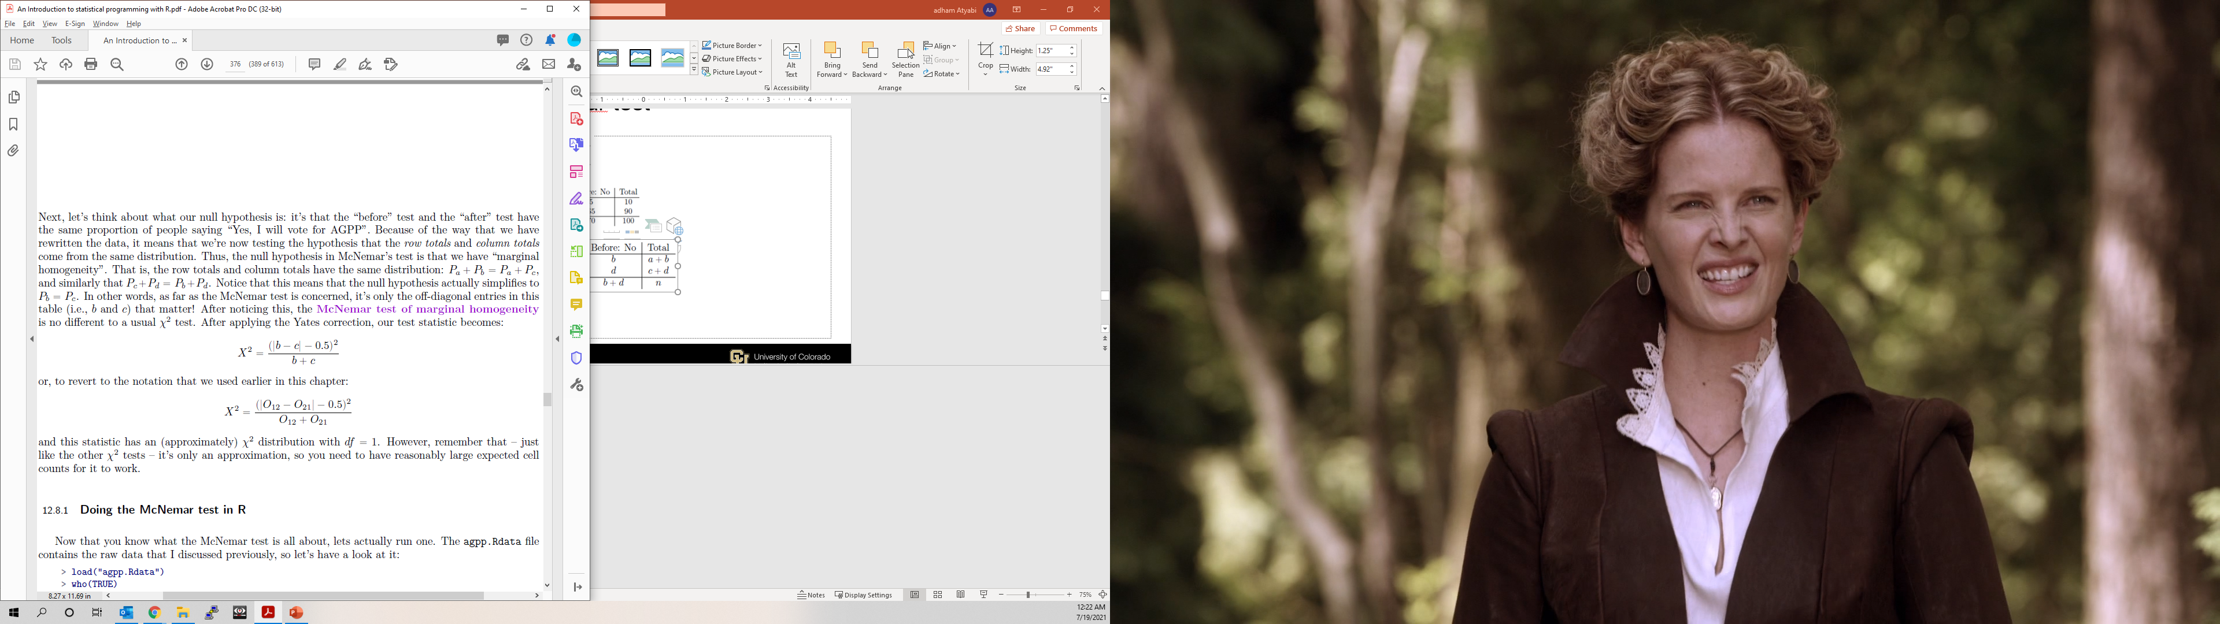
The McNemar test
Pa +Pb = Pa +Pc
Pc+Pd = Pb+Pd
Pb = Pc

Slide 53
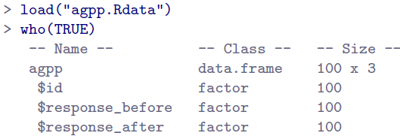
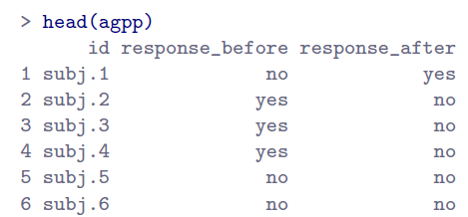
Doing the McNemar test in R
> summary(agpp)
id response_before response_after
subj.1 : 1 no :70 no :90
subj.10 : 1 yes:30 yes:10
subj.100: 1
subj.11 : 1
subj.12 : 1
subj.13 : 1
(Other) :94

Slide 54
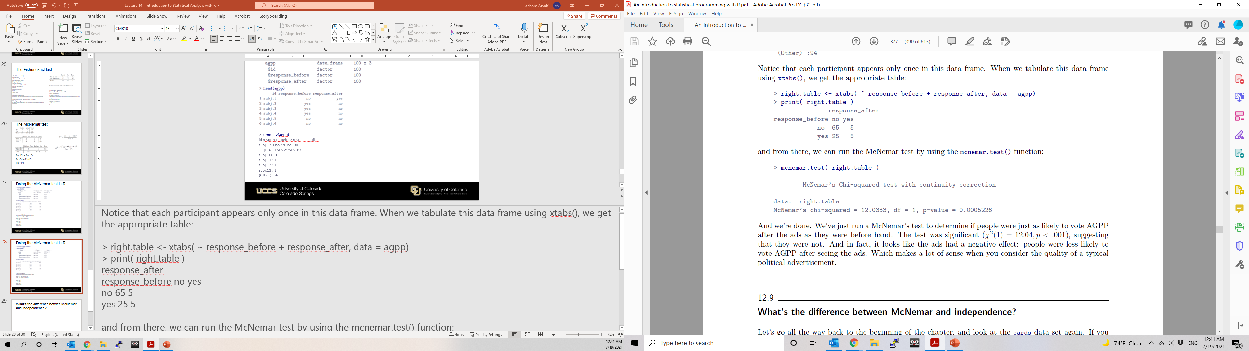
Doing the McNemar test in R

Slide 55
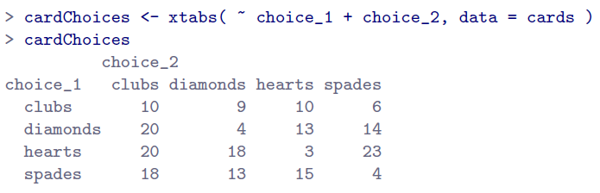
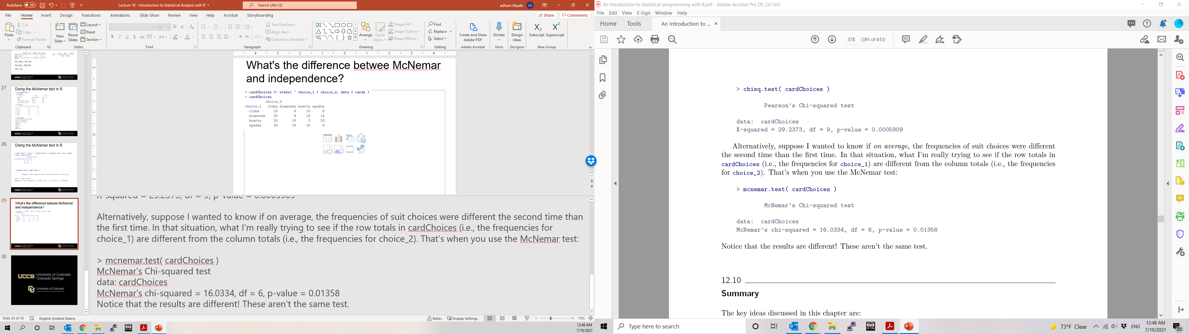
Using McNemar and Chi-square test of independence?

Slide 56
In Class Reading and Discussion
Today’s reading is Chapter 9: Hypothesis Testing
Sections 9.4 – 9.6
Key Reading: Understanding Hypothesis Tests
Assigned time: 30 mins. 3:50 pm – 4:15 pm

Slide 57
In Class Exercise
Due at 11:59 pm
With a minimum of 250 words, in your own words, describe the key knowledge you have gained about hypothesis testing from today's lecture. The major expectation is writing clearly and concisely what you have learned from the class lecture.

